Slide 1
Online Inventory Management System
Name: Md. Sohel Rana
Roll: 372706
5/CMT/A2

Slide 2
Contents
Introduction
Purpose Of Project
Software Requirement
Hardware Requirement
Operational Concepts
Data Flow Diagram
Snapshots
Conclusion

Slide 3
Introductions
This project is aimed at developing an online Sales and Inventory Management System (SIMS) for a departmental store. This system can be used to store the details of the inventory, update the inventory based on the sale details, produce receipts for sales, generate sales and inventory reports periodically etc. This is one integrated system that contains both the user component (used by salespersons, sales managers, inventory managers etc.) and the admin component (used by the administrators for performing admin level functions such as adding new items to the inventory, changing the price of an item etc.).
This system runs on multiple terminals, offers a GUI interface to its users and connects to a common database(s).

Slide 4
Purpose Of The Project
The main goal of Inventory Management System is to ensure consistent availability of supplies for consumers. Thus, Inventory Management System is directed toward owners of small to large stores and stock managers who are responsible of maintaining sufficient goods on hand in a retail or manufacturing business. It can scale from a single computer running both client and server software up to multiple stores and warehouses.

Slide 5
Software Requirements
Operating System : Windows or Linux or Mac
Database: My SQL
XAMPP Control panel (As Local Server)
Apache Tomcat
Atom (Text Editor)

Slide 6
Hardware Requirements
Processor :Intel Pentium III or equivalent
Required RAM :512 MB
720 MB of available hard-disk space
20 GB Hard-disk for store required content

Slide 7
Operational Concept
The Inventory Management System is a real-time inventory database capable of connecting multiple stores. This can be used to track the inventory of a single store, or to manage the distribution of stock between several branches of a larger franchise. However, the system merely records sales and restocking data and provides notification of low stock at any location through email at a specified interval. The goal is to reduce the strain of tracking rather than to handle all store maintenance. Further features may include the ability to generate reports of sales, but again the interpretation is left to the management. In addition, since theft does occasionally occur, the system provides solutions for confirming the store inventory and for correcting stock quantities.

Slide 8
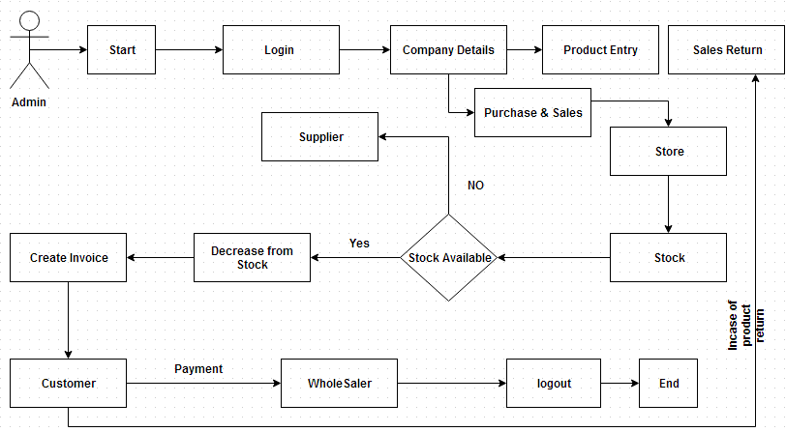
Data Flow Diagram

Slide 9
Snapshots

Slide 10
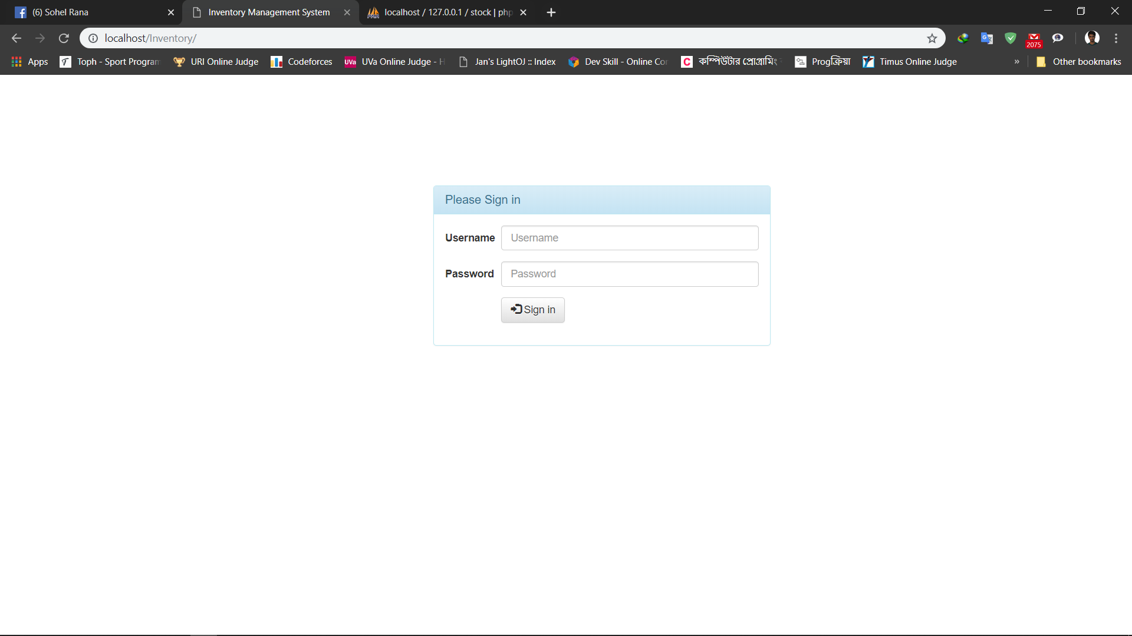

Slide 11
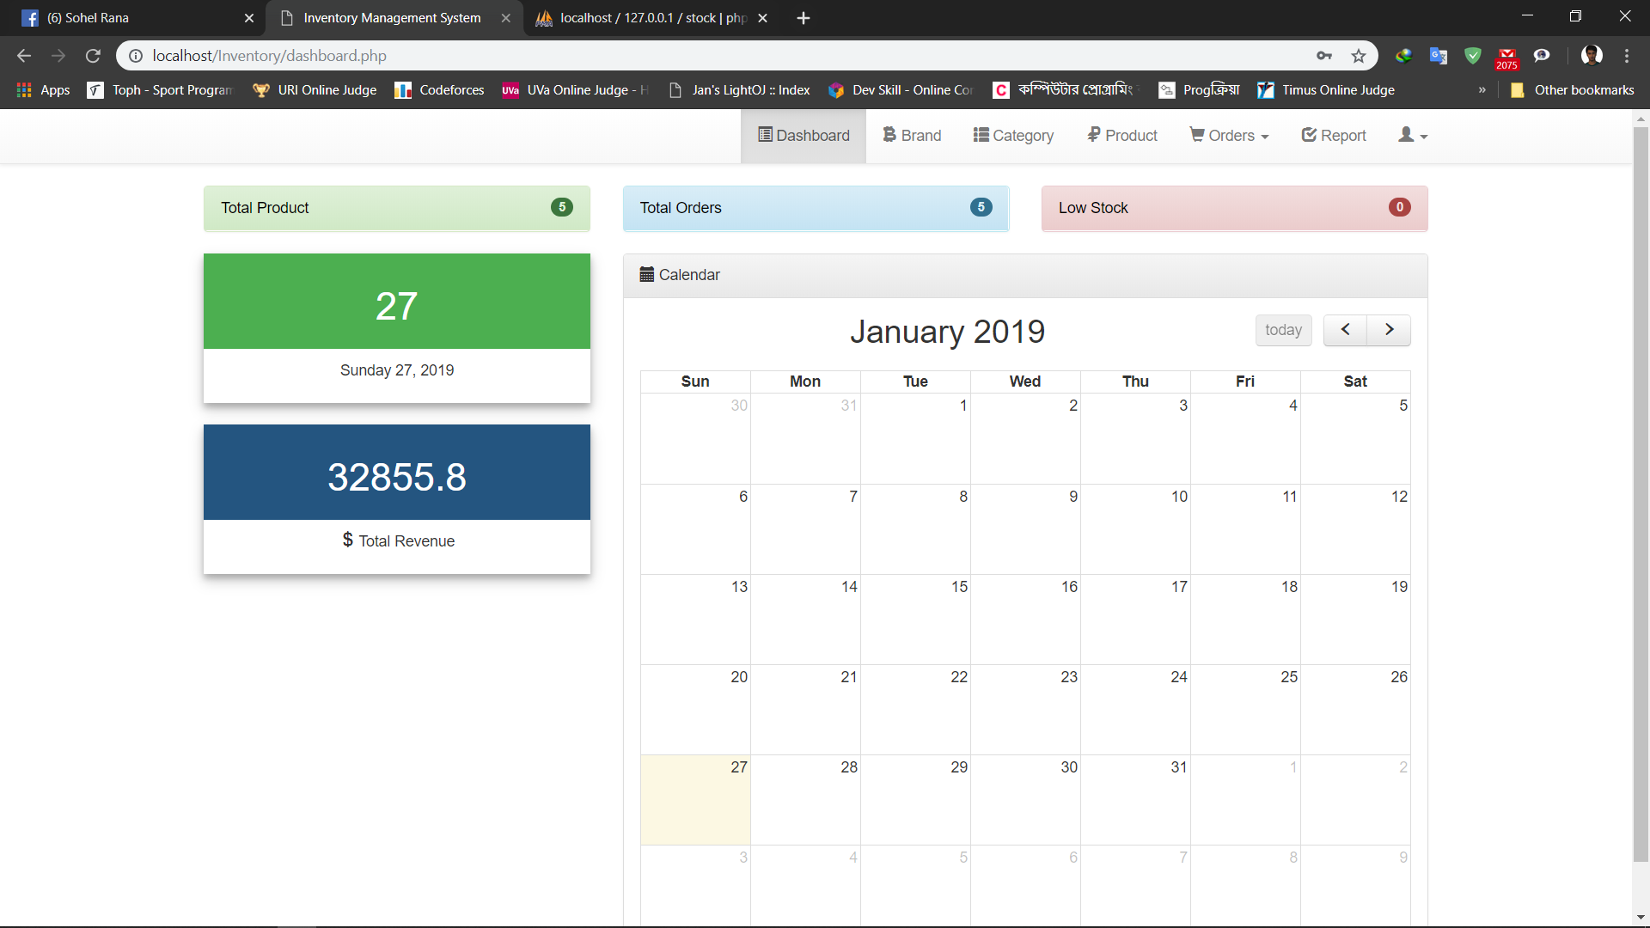

Slide 12
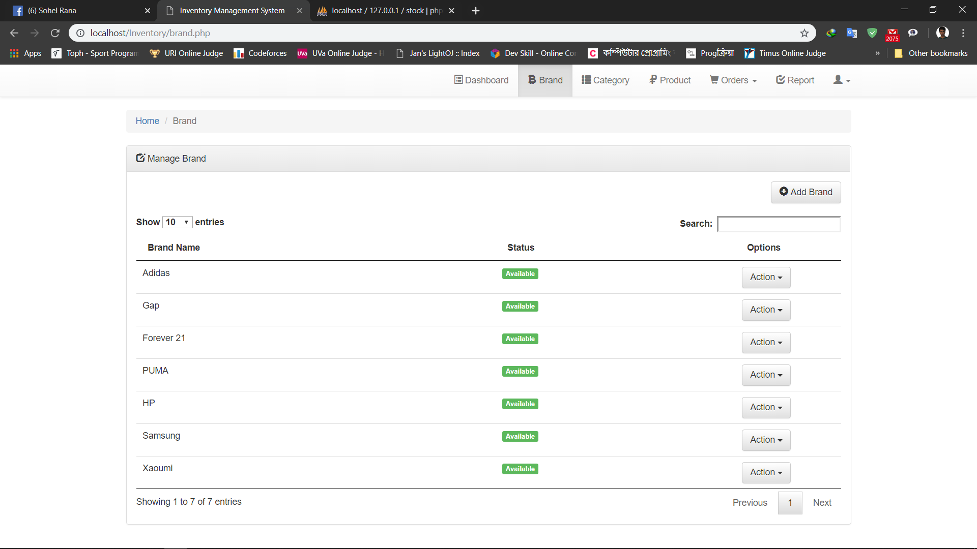

Slide 13
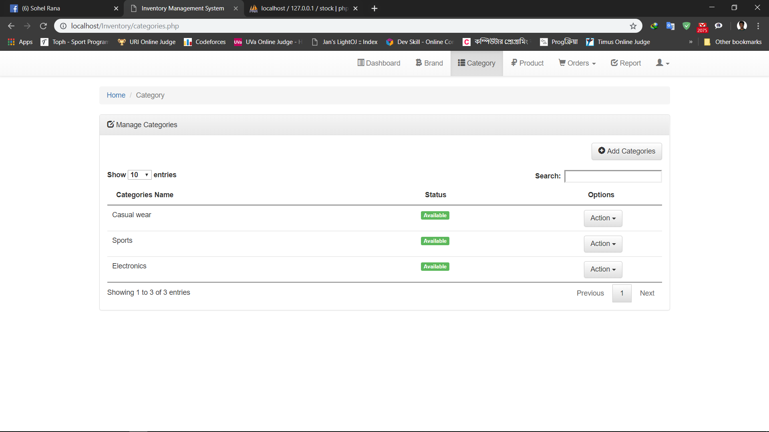

Slide 14
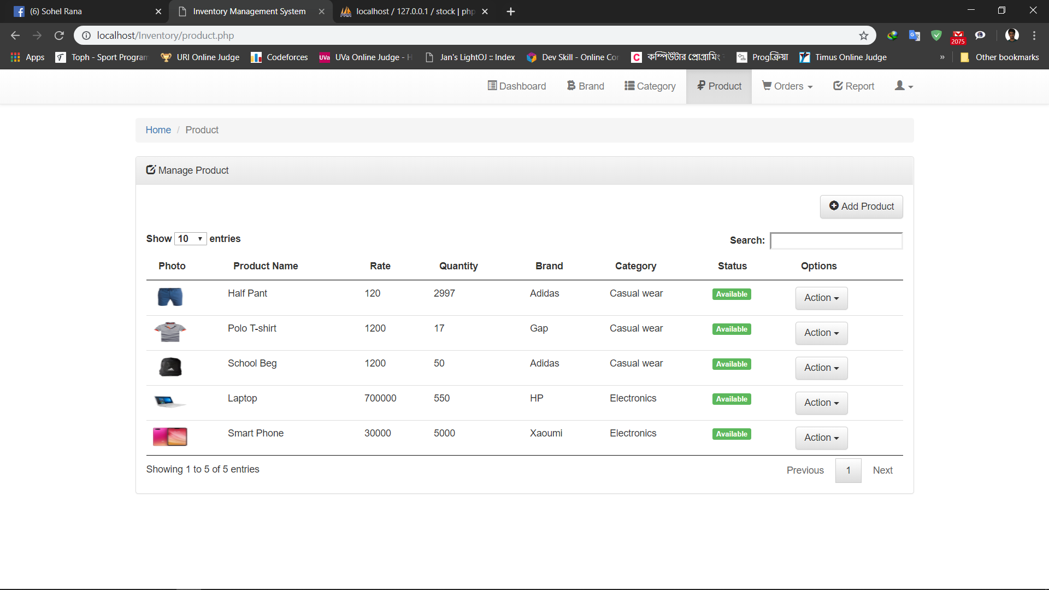

Slide 15
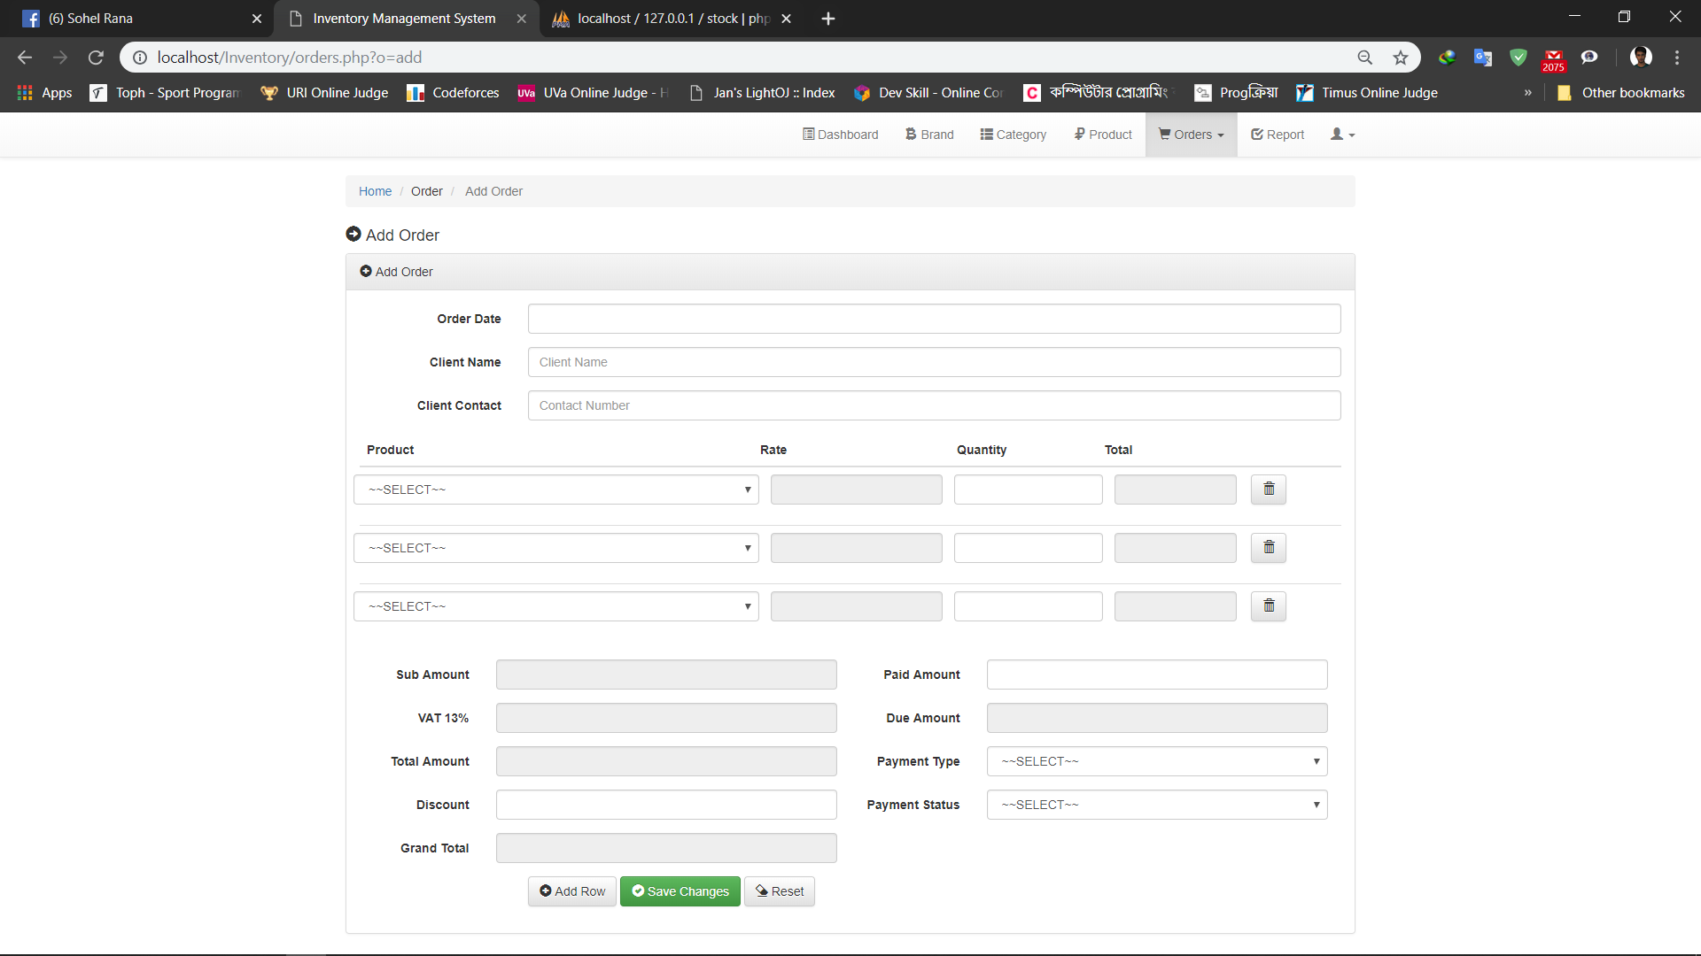

Slide 16
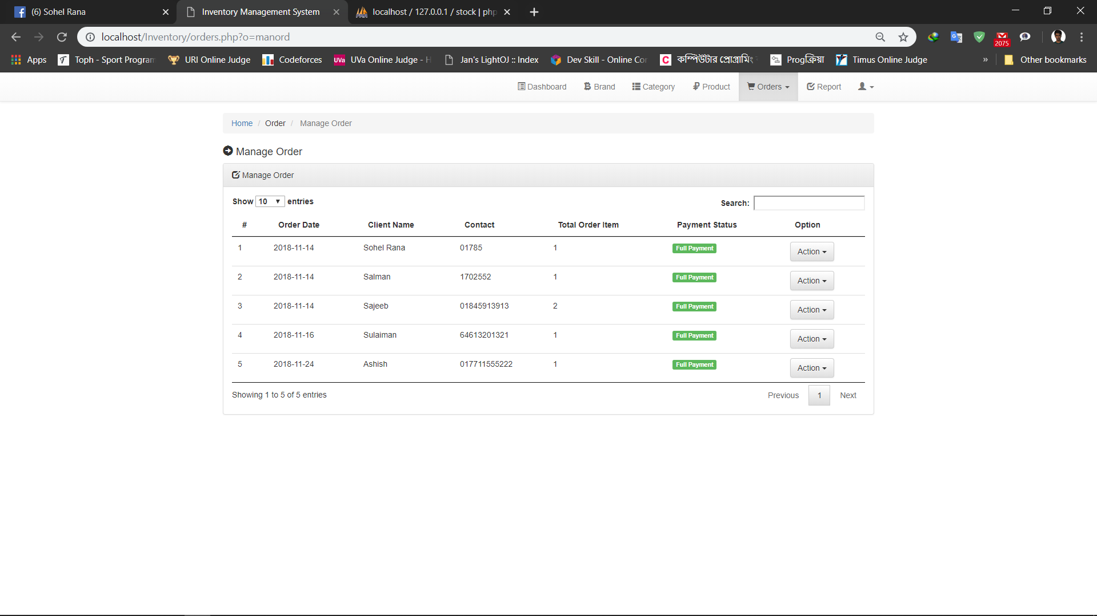

Slide 17
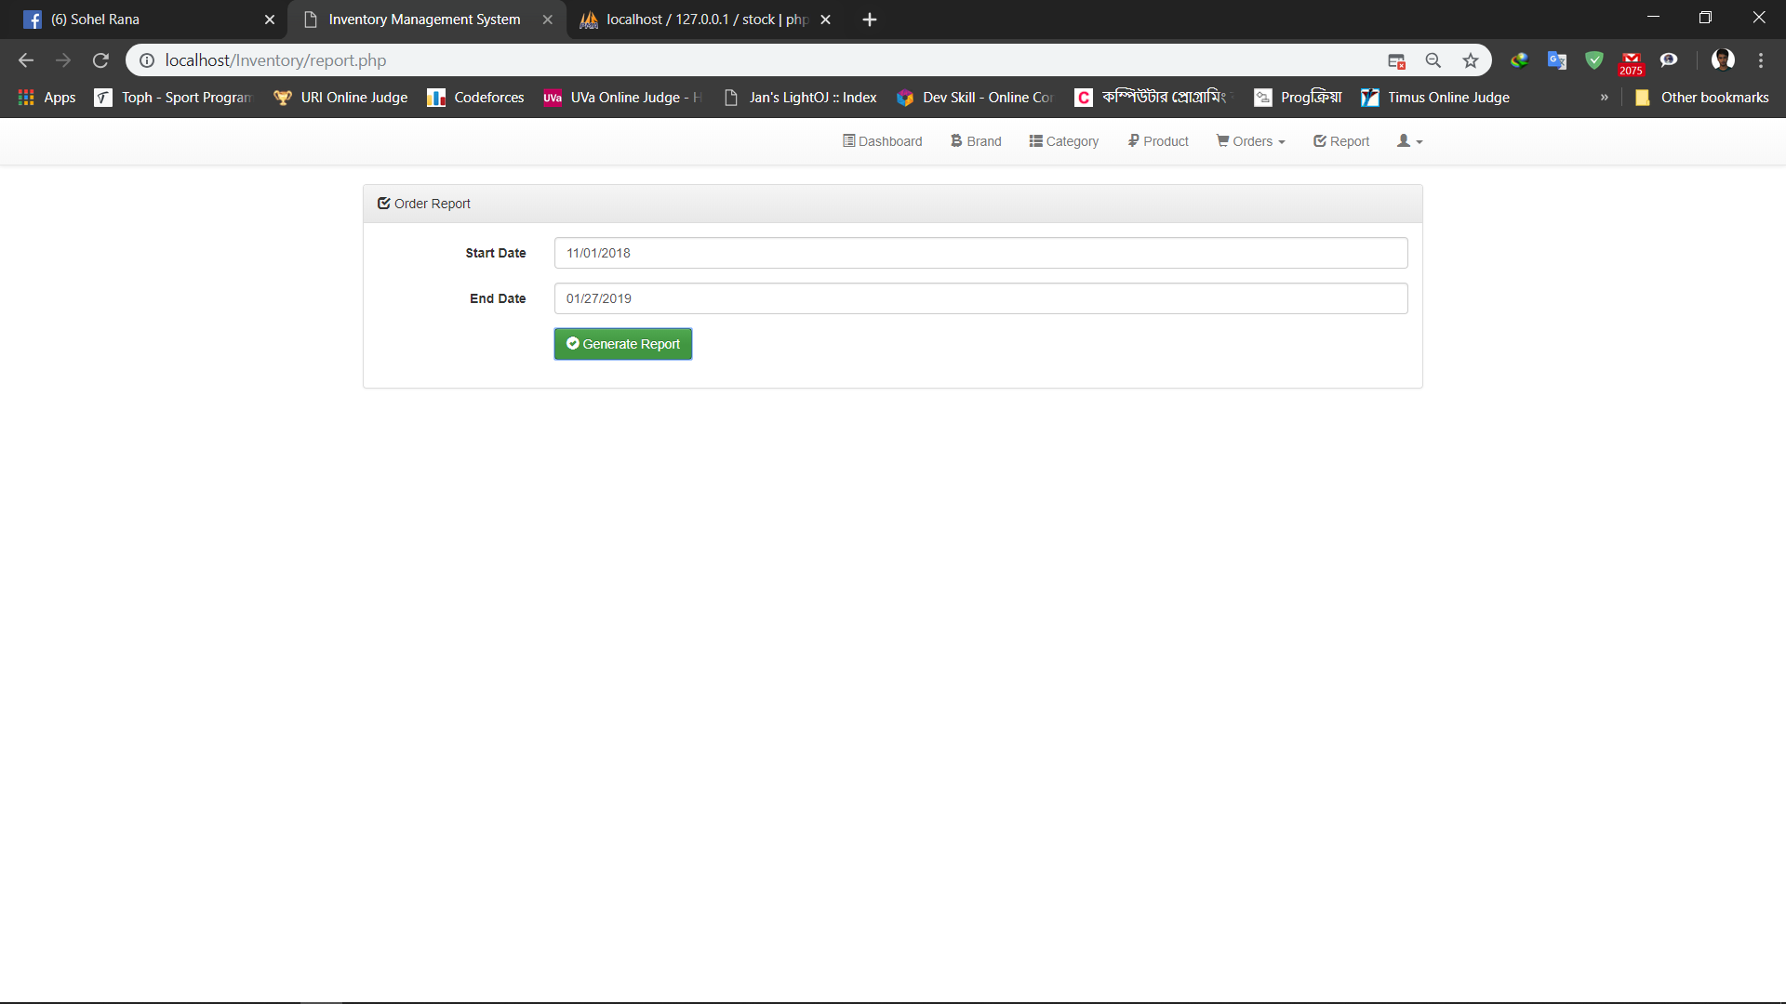

Slide 18
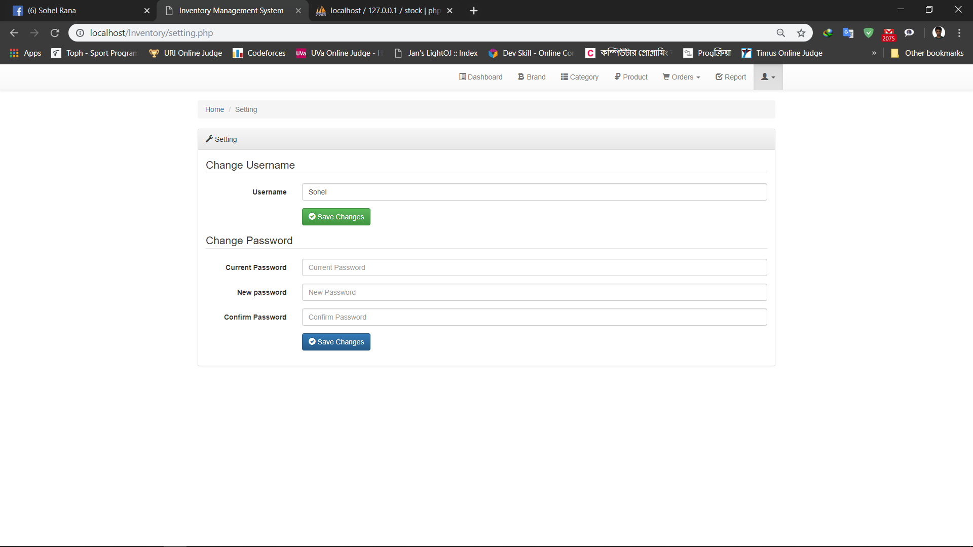

Slide 19
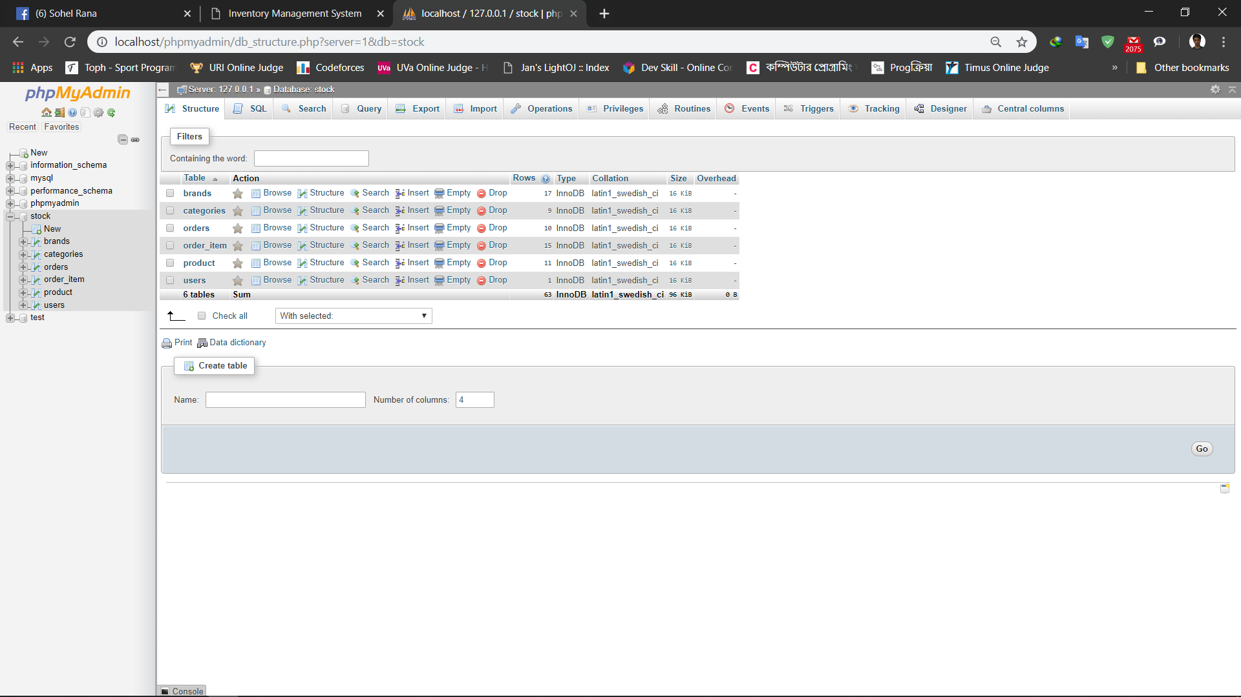

Slide 20
Conclusion
To conclude, Inventory Management System is a simple desktop based application basically suitable for small organization. It has every basic items which are used for the small organization. Our team is successful in making the application where we can update, insert and delete the item as per the requirement. This application also provides a simple report on daily basis to know the daily sales and purchase details. Through it has some limitations, our team strongly believes that the implementation of this system will surely benefit the organization.

Slide 21
Thank You

